Slide 1
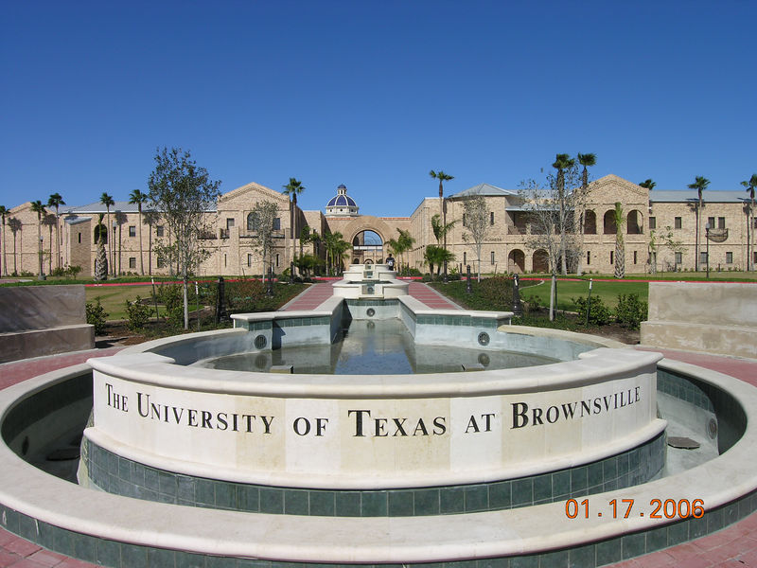


Locate Potential Support Vectors for Faster
Sequential Minimal Optimization
Hansheng Lei, PhD
Assistant Professor
Computer and Information Sciences Department

Slide 2
Outline
Background and Overview
Fisher Discriminant Analysis (FDA)
SVM vs. FDA
Combining FDA and SVM
Experimental Results
Computing Infrastructure at UT Brownsville
Application Projects

Slide 3
Classification
w x + b>0
w x + b=0
How to classify this data?
w x + b<0

Slide 4
α
Linear Classifiers
x
f
y
f(x,w,b) = sign(w x + b)
How to classify this data?

Slide 5
α
Linear Classifiers
x
f
y
f(x,w,b) = sign(w x + b)
How to classify this data?

Slide 6
α
Linear Classifiers
x
f
y
f(x,w,b) = sign(w x + b)
which is best?

Slide 7
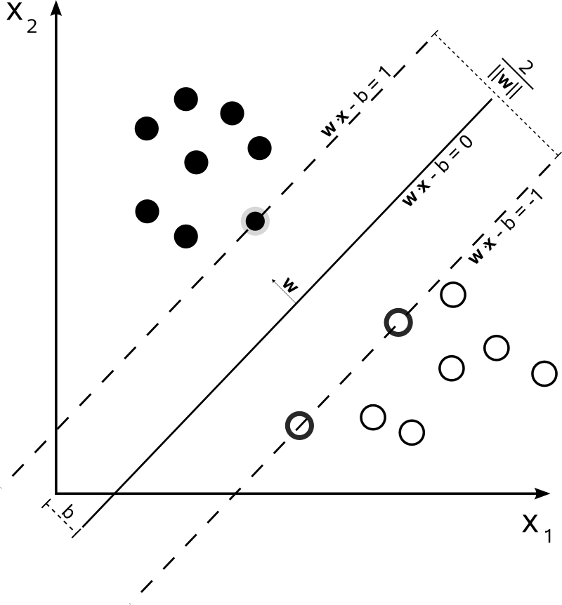
Linear SVM

Slide 8


Solving the Optimization Problem
Find w and b such that
Φ(w) =½ w^{T}w is minimized;
and for all {(x_{i} ,y_{i})}: y_{i} (w^{T}x_{i} + b) ≥ 1
Subject to

Slide 9
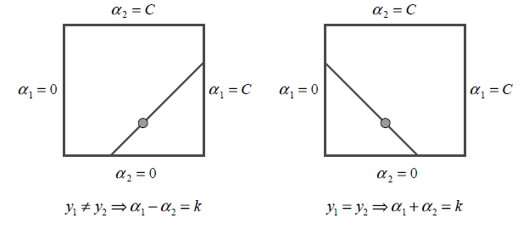
Sequential Minimal Optimization (SMO) John C. Platt, 1998
The algorithm proceeds as follows:
1. Find a Lagrange multiplier α₁ that violates KKT conditions for the optimization problem.
2. Pick a second multiplier α₂ and optimize the pair (α₁,α₂).
3. Repeat steps 1 and 2 until convergence.
Heuristics are used to choose the pair of multipliers so as to accelerate the rate of convergence.

Slide 10
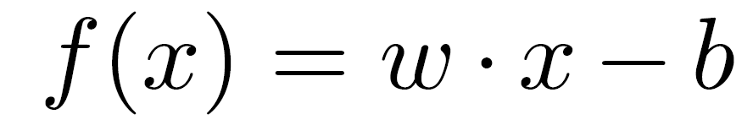


SVM vs. Fisher Discriminant Analysis
1. Similar Format:

Slide 11
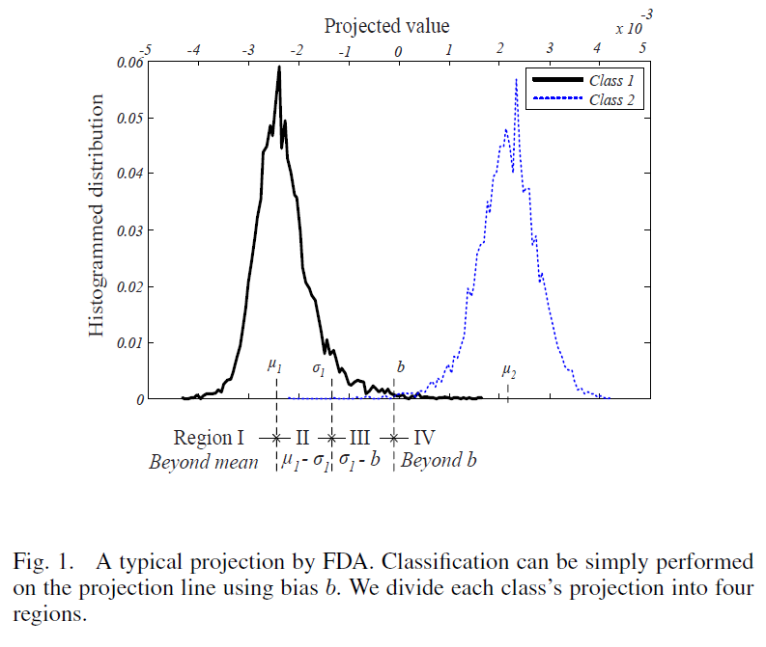
SVM vs. Fisher Discriminant Analysis
2. Similar Projection:

Slide 12
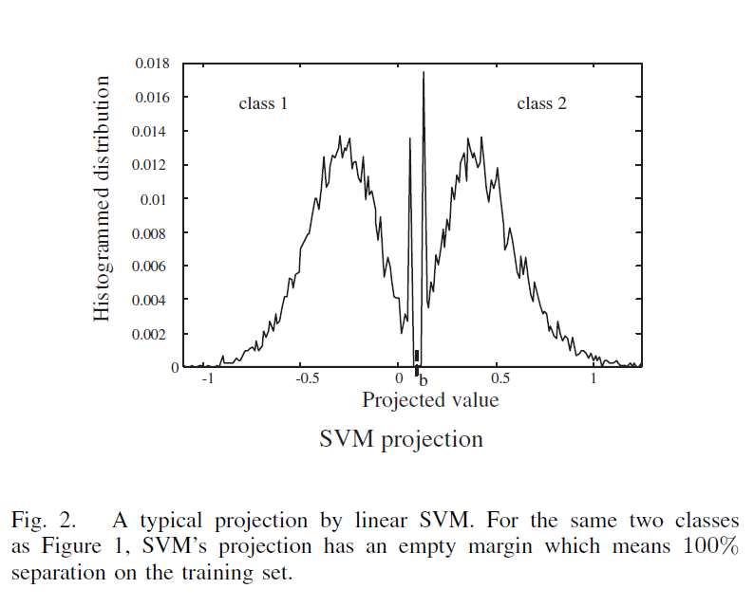
SVM vs. Fisher Discriminant Analysis
2. Similar Projection:

Slide 13
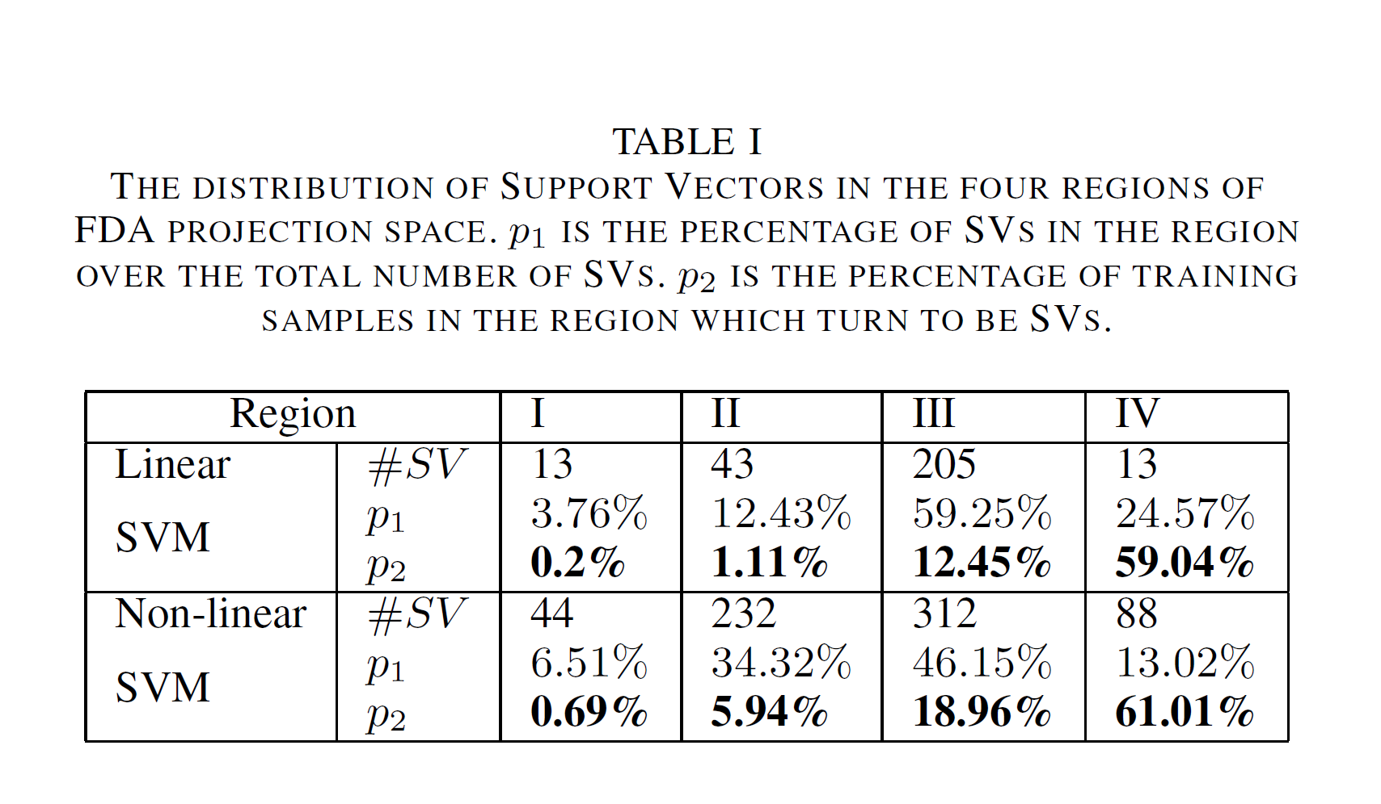
Distribution of Support Vectors (SV)

Slide 14
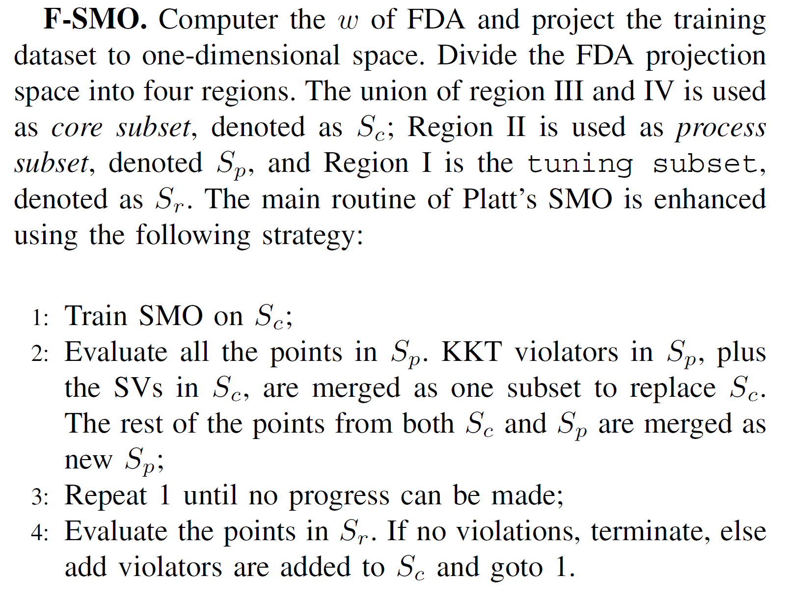
F-SMO = FDA+SMO

Slide 15
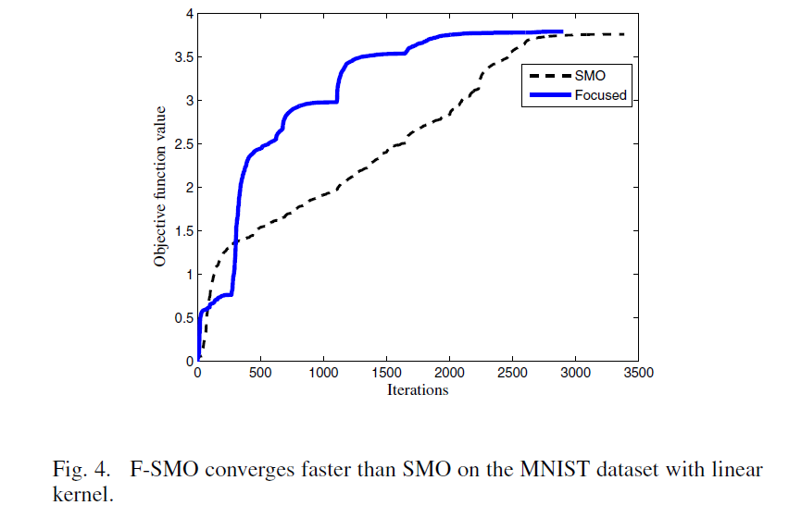
Experimental Results

Slide 16
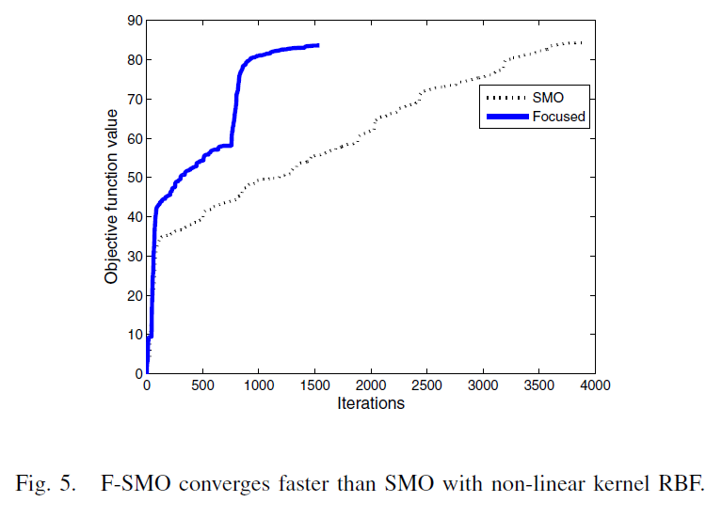
Experimental Results

Slide 17
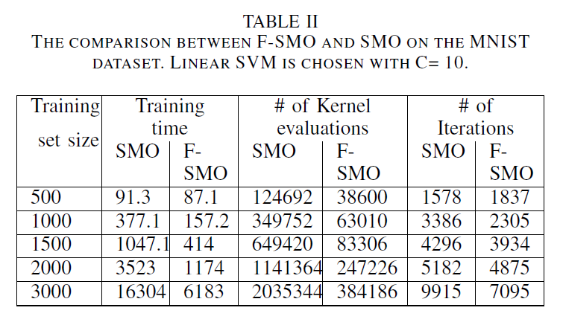
Experimental Results

Slide 18
Experimental Results

Slide 19
Experimental Results

Slide 20
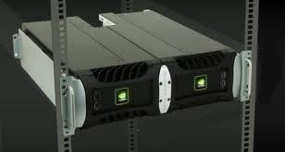
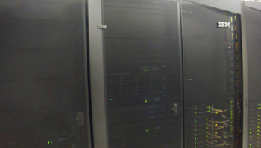
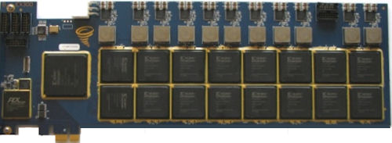
Computing Infrastructure
Graphics Processing Unit (GPU)
Cluster
Field-programmable gate array (FPGA)
GPU Visualization
Advanced CM Flex Lab

Slide 21
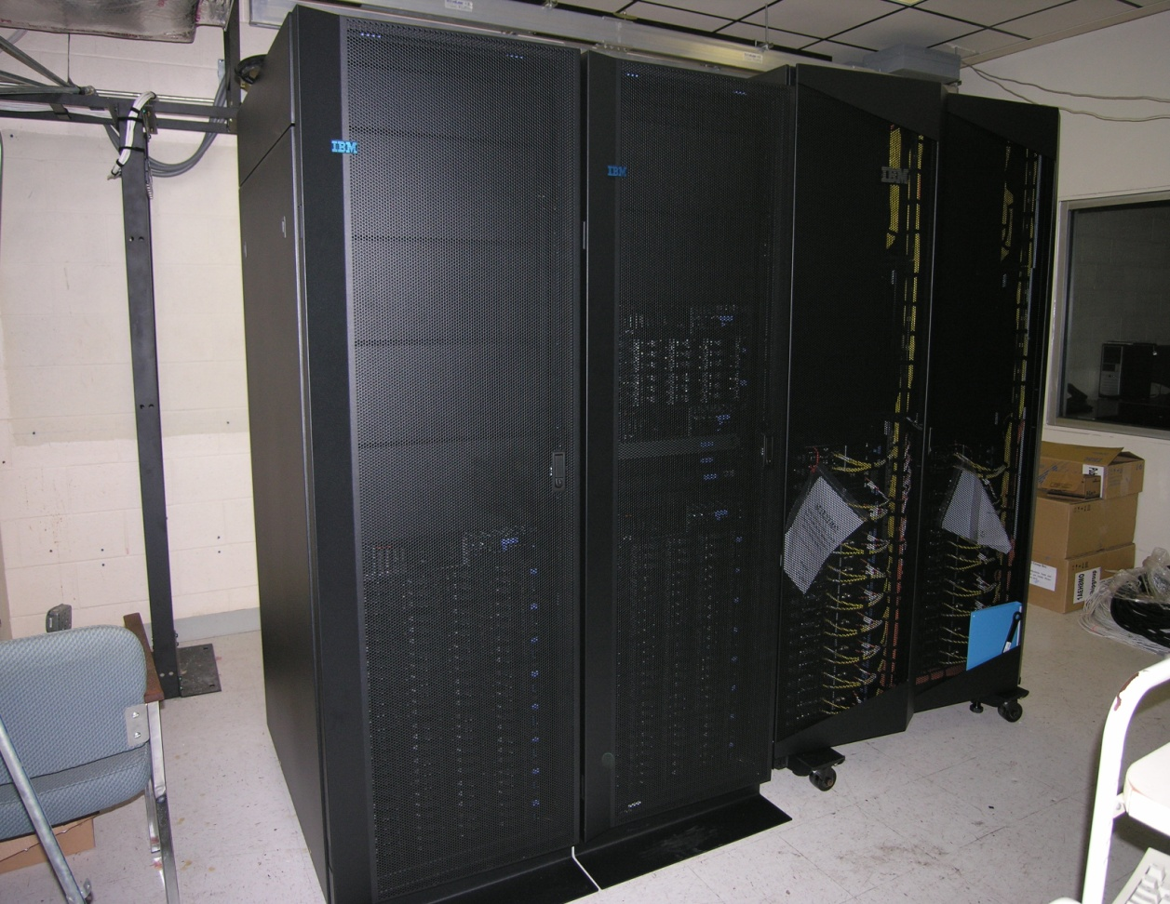

FUTURO cluster
IBM® iDataPlex
320 Cores @ 2.4Ghz
216 TB Storage
QDR Infiniband @ 40Gbps
40 Intel®XeonE5540 nodes
192GB RAM per node max
24 TB RAID per node max
NSF MRI funded

Slide 22
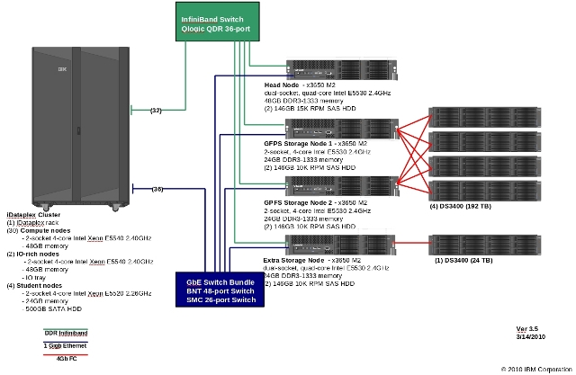
Futuro Architecture Design

Slide 23
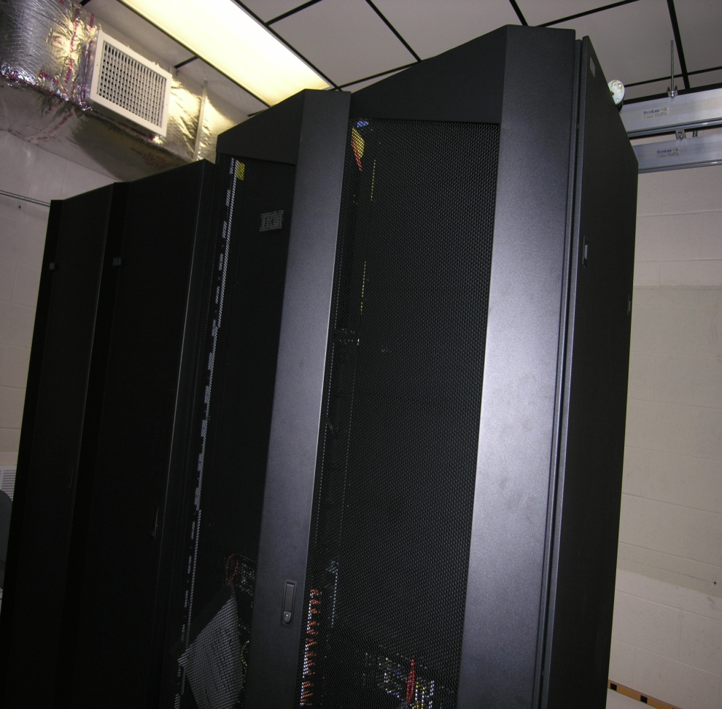
FUTURO

Slide 24
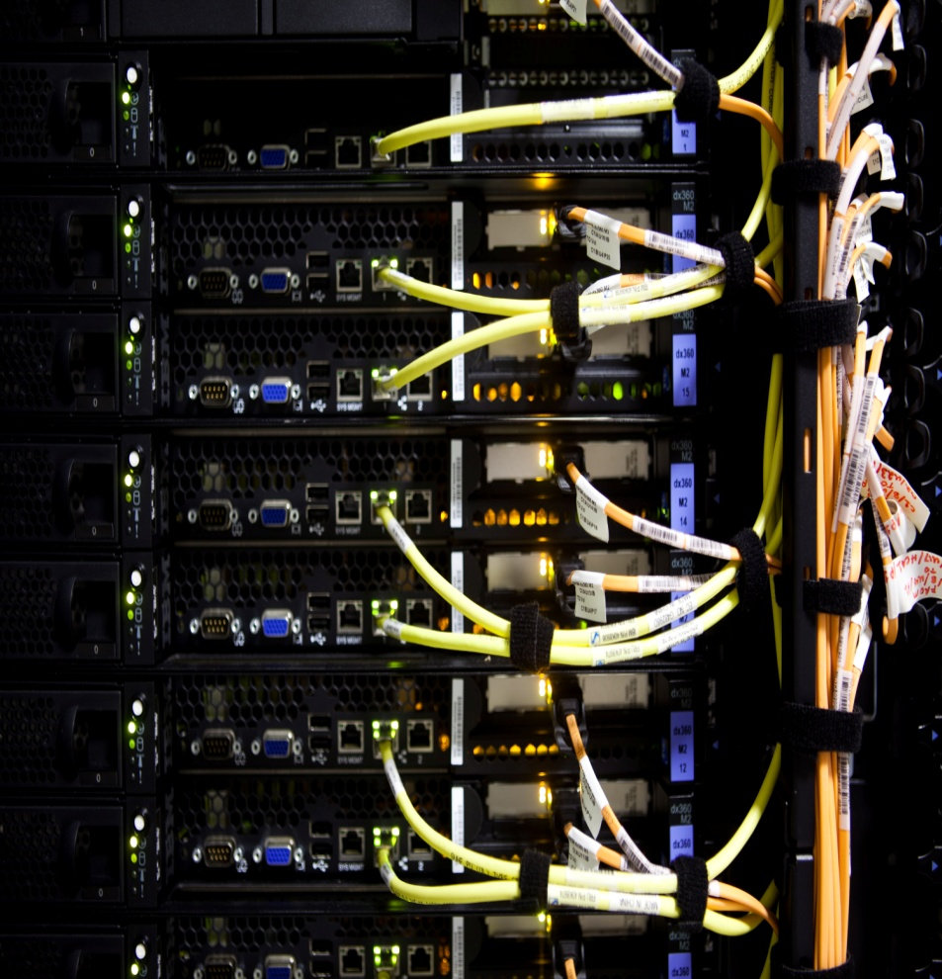
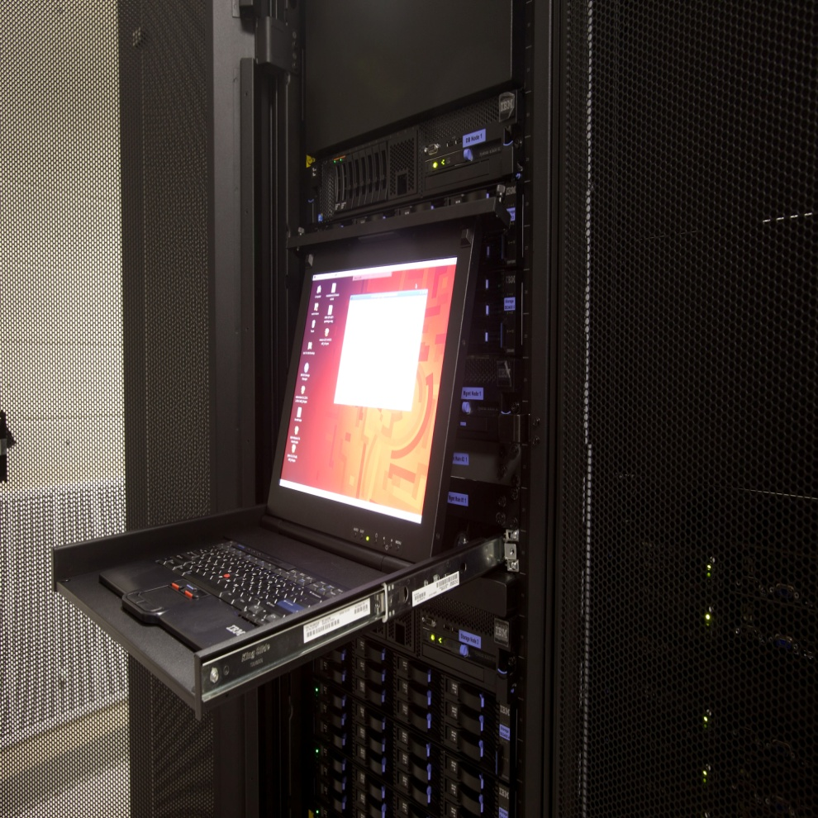
FUTURO Gallery

Slide 25
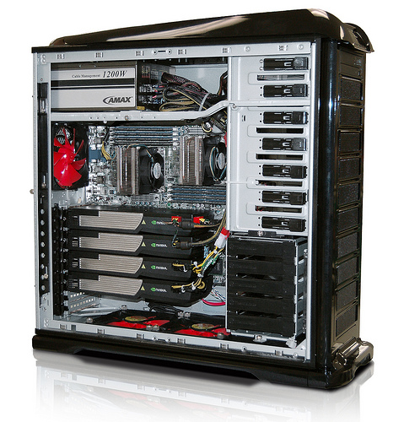
GPU Server
AMAX® ServMax PSC-2n
940 GPU Cores @ 1.3Ghz
12 CPU Cores @ 2.8 Ghz
4 teraflops max
80 GB memory max
4 Nvidia®Tesla nodes
2 Intel® Xeon EP 5600
NSF MRI funded

Slide 26
FPGA Computing
1.2M logic cells
80K system gates
1.1M flip flops
1.7K 18x18Multipliers
532K Slices
16 Xilinx®Spartan FPGAs
Impluse C supported
NSF LSAMP funded

Slide 27
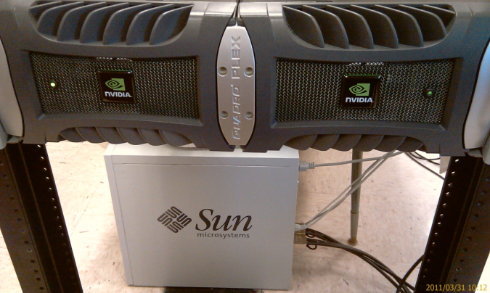

GPU Visualization
Dual Nvidia®QuadroPlex
960 Nvidia® CUDA cores
3.73 Teraflops
33.3 Mega Pixels
7680x4320 resolution
16 GB Frame Buffer
3D Stereo
US ED CCRAA funded

Slide 28
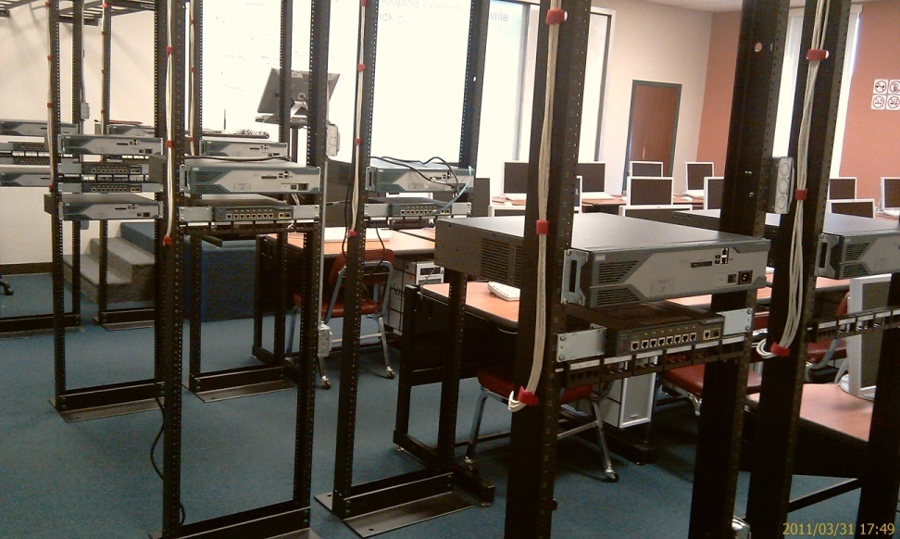
Computational Science Flex Lab
32 SUN Ultra nodes
Intel® Q9650 @ 3.0 Ghz
128 CPU Cores
1024 CUDA Cores
320GB RAM
8.8TB Storage
US ED CCRAA funded

Slide 29
Enabled Projects
1. Tracking LIGO Detector Noise for Gravitational Wave Detection (NSF)
2. Genetic Data Analysis in Complex Human Diseases (University of Texas Health Science Center)
3. Dynamical Systems and Stellar Populations(NASA)
4. Collaborative Filtering using Multispectral Information(*)
5. Visualization of High-dimensional Data (NSF pending)
6. Practical Algorithms for the Subgraph Isomorphism Problem

Slide 30
Tracking LIGO Detector Noise for Gravitational Wave Detection (PI: Lei, Tang, Mukherjee, Mohanty, co-PI: Iglesias)
Subproject 1– Parallel and Distributed Clustering
Subproject 2 – Parallel and Distributed Classification
Subproject 3: Parallel and Distributed Rule Discovery
Computing infrastructure and distributed KDD research.

Slide 31
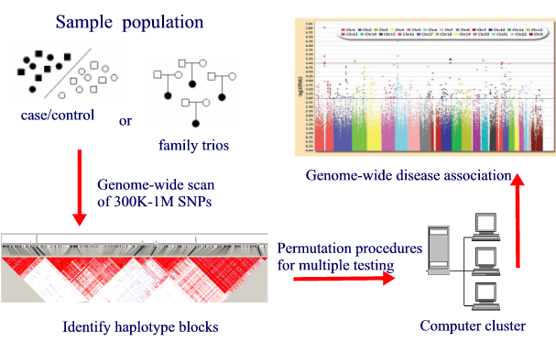
Genetic Data Analysis in Complex Human Diseases
(PI: Figueroa)
Genetic data analysis.

Slide 32
Visualization of High-dimensional Data
(PI: Quweider , co-PI: Mukherjee, Mohanty)
Visualization Framework.

Slide 33
Application Projects
Automated optical inspection (AOI)
Special Sound Detection,

Slide 34
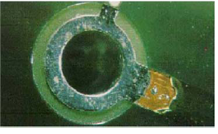
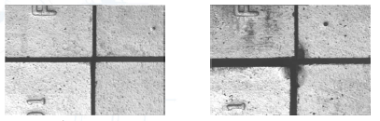
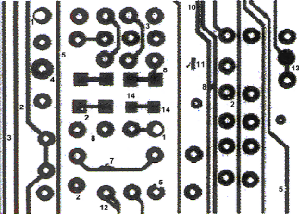
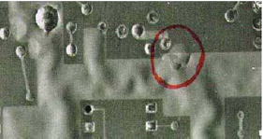
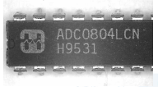

Automated Optical Inspection

Slide 35
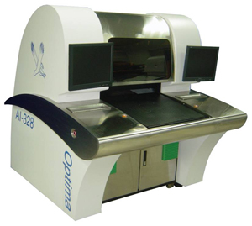
AOI components
Computer vision software
Machine vision hardware for data acquisition, e.g.. CCD camera and optical lens, or X-ray,
Auto control system
Illumination system
Optimal AOI, Viking Test Ltd

Slide 36
Special Sound Detection

Slide 37
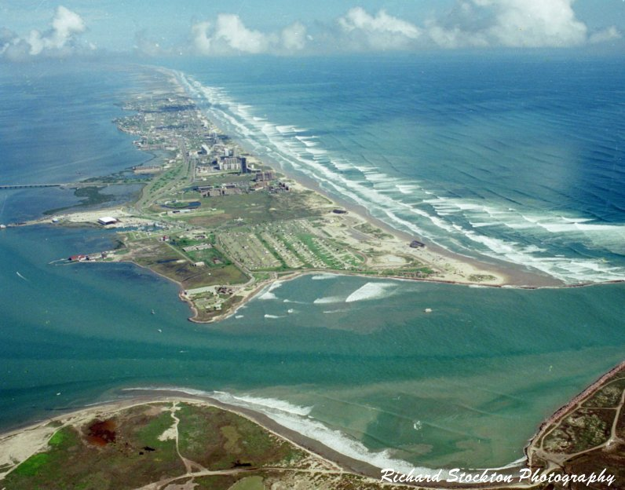
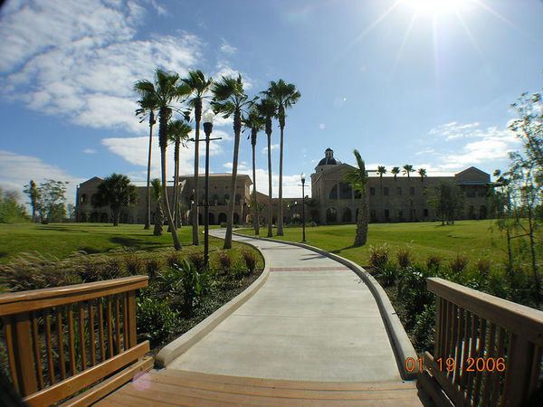
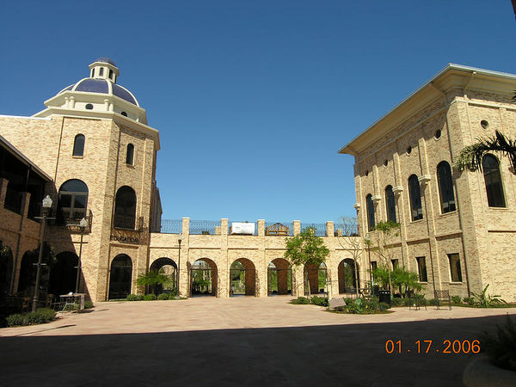
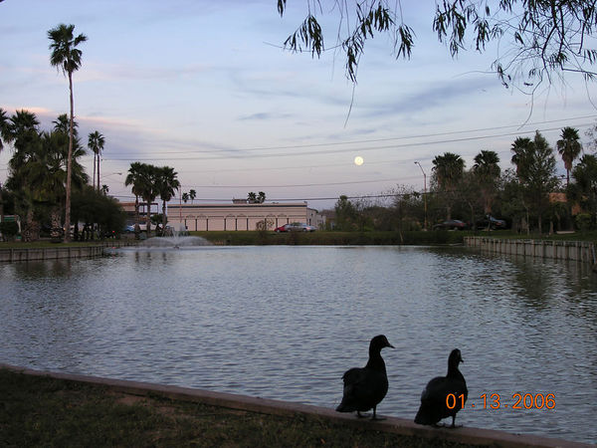
The End
Welcome to Visit UTB

