Slide 1
Grid Defense Against Malicious Cascading Failure
Paulo Shakarian, Hansheng Lei
Dept. Electrical Engineering and Computer Science, Network Science Center, U.S. Military Academy, West Point, NY
Roy Lindelauf
Netherlands Defense Academy
Faculty of Military Science
Military Operational Art and Science
Netherlands Defense Academy

Slide 2
Power Grid Cascading Failure
The power grid is heterogeneous – meaning large scale reconnaissance is difficult. However, to cause a cascade, the adversary may need to recon and attack a small portion of the power grid.
G
G
G
G
G
T
T
T
T
D
D
D
D
D
D
D

Slide 3
Outline
Introduction
Power grid modelling
Computational complexity
Algorithms
Experimental evaluation
Conclusion

Slide 4
Introduction
Cascading failure
Widespread power outages, observed in the US in 2003
Internet connectedness such networks can come under cyber attack, causing severe problems
A failure can be initiated with only a small number of initial node failures
Power grid infrastructure vulnerable with respect to cyber-security due to a variety of issues
Notes:
“The 2003 blackout's primary cause was a software bug in the alarm system at a control room of the FirstEnergy Corporation in Ohio. Operators were unaware of the need to re-distribute power after overloaded transmission lines.” --http://en.wikipedia.org/wiki/Northeast_blackout_of_2003

Slide 5
The Model
The Attacker conducts cyber-attacks against power grid infrastructure to disable certain substations that lead to a cascading failure
The Defender. Can harden a limited number of systems to prevent the attacker from causing them to fail

Slide 6
Assumptions
The defender cannot defend everything – as he can only take a small number of systems offline for maintenance
The defender should be able to defend (patch, update) systems according to a schedule that will prioritize different systems at different times
Deterministically focusing on only a few systems will allow the adversary to exploit the weaker, generally unpatched systems

Slide 7
Related work
Cascading failure models
Edge failure based on excessive loads
Power-flow mode
We focus more on strategies: explore strategies for attack and defense
Game theory
Game theory used in monitoring and decision making in smart grids. However, no game theoretic approach has been given for this specific problem

Slide 8
Problem
Attacker attempts to create a cascade that maximizes the impact of power failures while the defender defends key nodes to avoid a major outage

Slide 9
Our contribution
Derive a mathematical model for an attacker/defender game for smart grid failure
Analyze the time complexity of a various type of strategies
Presented heuristic greedy algorithm, linear program optimization, and double-oracle simulation
Performed Initial experiments on a real-world dataset
Inside Findings!

Slide 10
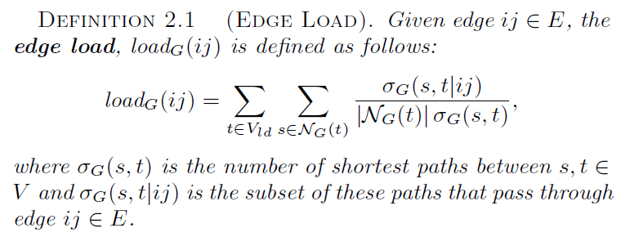
power-grid network modelling
A power-grid network modeled as an undirected
graph G = (V;E). Vsrc, Vld be source (producers of power) and load (consumers of power) on the network
Key definitions:

Slide 11
power-grid network modelling
Key definitions

Slide 12
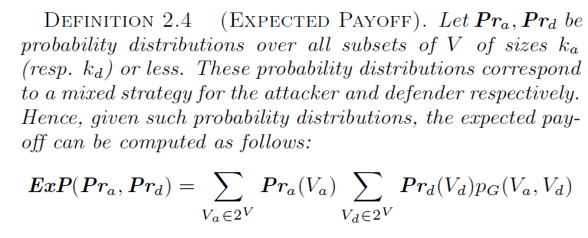
power-grid network modelling
Key definitions

Slide 13
Computational Complexity

Slide 14
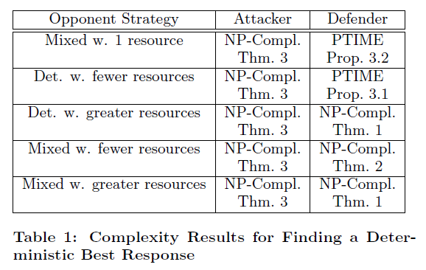
Computational Complexity

Slide 15
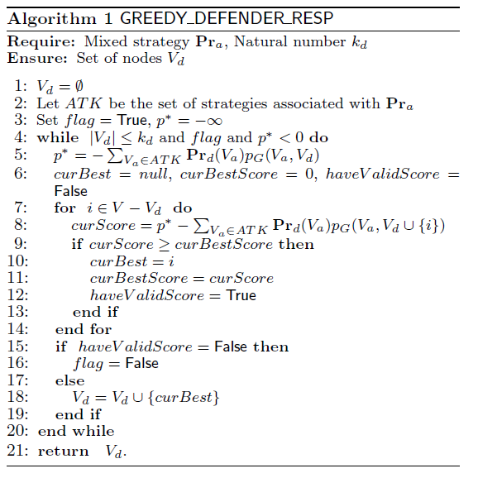
Algorithms

Slide 16
Algorithms

Slide 17
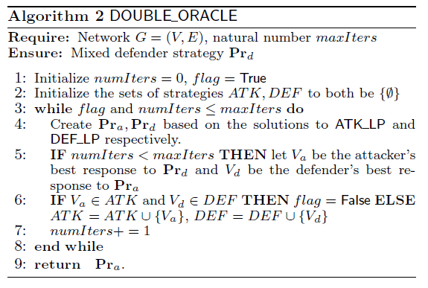
Algorithms

Slide 18
Experimental Evaluation
Dataset: an Italian 380kV power transmission grid.
310 nodes, 113 were source, 96 were load, and the remainder were transmission nodes
the nodes were connected with 361 edges representing the power lines.
All experiments were run on a server with
An Intel X5677 Xeon Processor, 3.46Ghz with12 MB Cache
288 GB of physical memory.
Hat Enterprise Linux version 6.1.

Slide 19
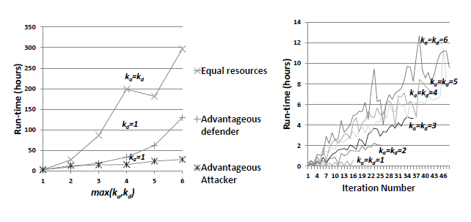
Experimental results: run-time

Slide 20
Experimental results: double oracle

Slide 21
Experimental results: double oracle

Slide 22
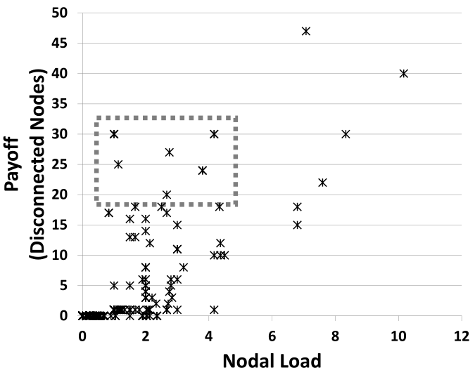
Findings

Slide 23
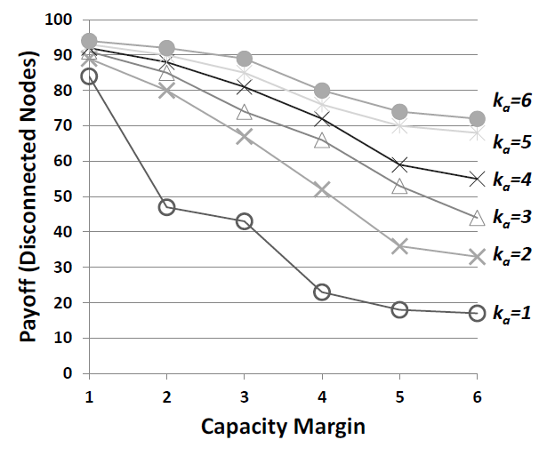
Findings

Slide 24
Findings

Slide 25
Findings

Slide 26
Conclusion
We explored complexity, algorithmic, and implementation issues in a two-player security game where the attacker/defender look to create/mitigate cascading failure on a power grid.
Future work
Further experiments on other datasets
Further studies to understand how to employ the defense
schedule in a real-world setting
Larger network, distributed algorithms

Slide 27
Questions?

