Slide 1
Data Intelligence
Hansheng Lei
Univ. of Texas Rio Grande Valley

Slide 2
Outline
Artificial Intelligence (AI) vs. Data Intelligence (DI)
DI Examples
Mining Dependent Patterns
Discovering Multiple Relations
Predict Prices
Summary
ICDIS 2019 – The 2nd Int. Conf. on Data Intelligence and Security

Slide 3
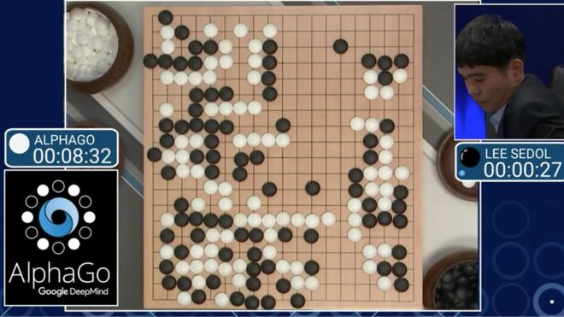
AI
a machine mimics "cognitive" functions that humans associate with other human minds, such as "learning" and "problem solving"
Artificial intelligence: Google's AlphaGo beats Go master Lee Se-dol, March 12, 2016

Slide 4
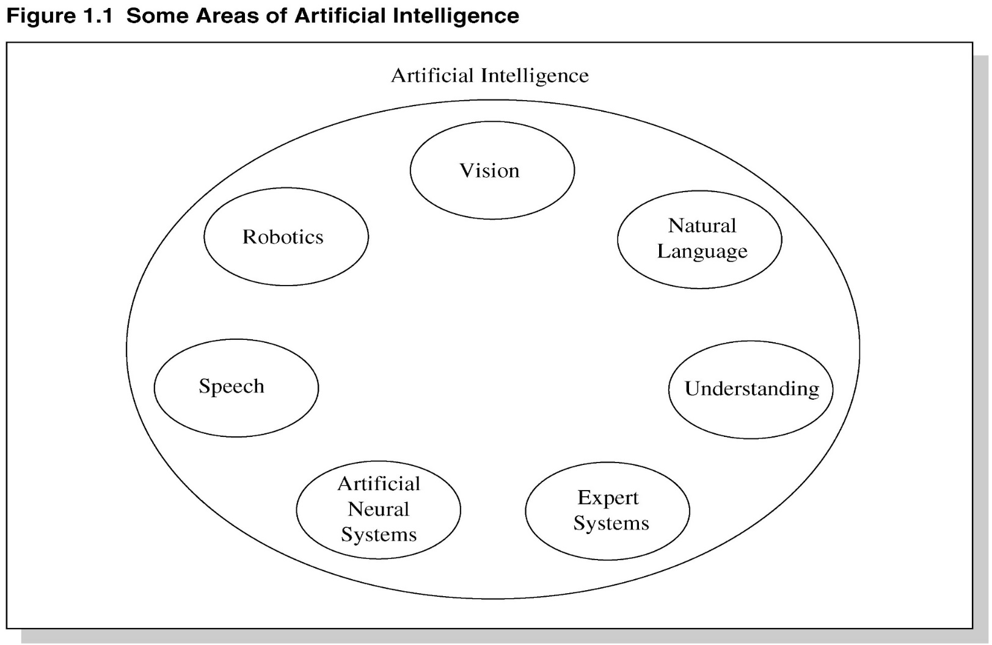
AI
Since the beginning of Computer

Slide 5
Data Intelligence
Combination of AI and machine learning (ML)
Descriptive: For reviewing and examining the data to understand and analyze business performance.
Prescriptive: For developing and analyzing alternative knowledge that can be applied in the courses of action
Diagnostic: For determining the possible causes of particulate occurrences.
Predictive: For analyzing historical data to determine future occurrences.
Decisive: For measuring the data adequacy and recommending future actions to be undertaken in an environment of multiple possibilities.

Slide 6
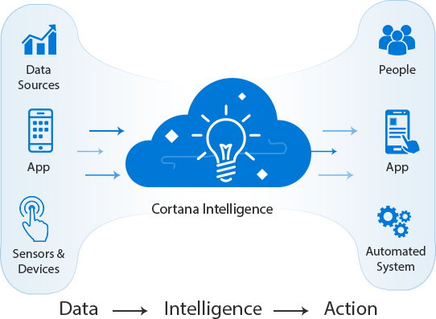
DI
Picture source: https://www.quora.com/What-is-data-intelligence

Slide 7
Association Rule Mining
Proposed by Agrawal et al in 1993.
Applied in market basket analysis to find how items purchased by customers are related.
Beer → Diaper [sup = 5%, conf = 100%]

Slide 8
Association rules
An association rule is an implication of the form:
X → Y, where X, Y ⊂ I, and X ∩Y = ∅
An itemset is a set of items.
  E.g., X = {milk, bread, cereal} is an itemset.

Slide 9
Problems with AR mining
generates a huge amount of rules
Not supporting other relations, such as negative implication, correlation and dependence
Universal support and confidence

Slide 10
Dependent Patterns

Slide 11
DP Properties
Downward closure
Individual support thresholds for each item
Right dependence measure

Slide 12
Pattern Distribution

Slide 13

Discovering Multiple Relations
In traditional statists, multiple regression is often used find the relations between a set of variables and a single dependent variable.
$y=α_{1}x_{1}{+α}_{2}x_{2}+…{+α}_{n}x_{n}+ε$

Slide 14
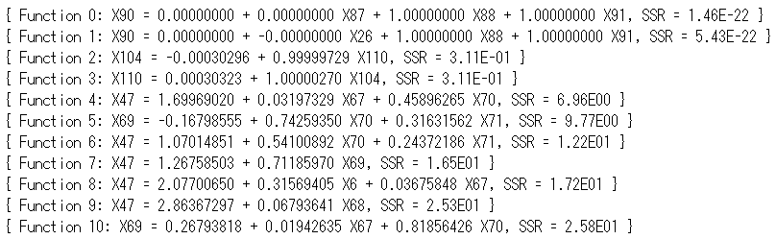
Discovering Multiple Relations
Top ten functions from output sorted by SSR (sum of squared residuals).

Slide 15

Predicting Prices

Slide 16
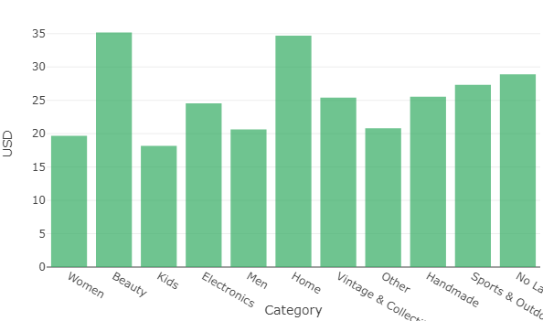
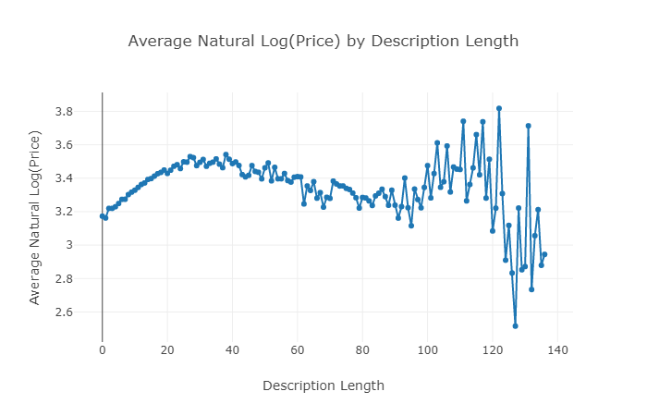
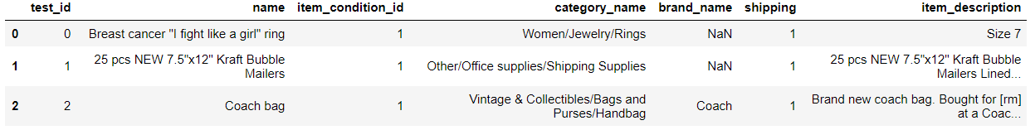
Predicting Prices
Mean Price by Main Category
Average Price by Description Length

Slide 17

ICDIS 2019
Volunteers wanted!

